Slide 1

Robotics is Fun
Presented By
The Assembly Team

Slide 2
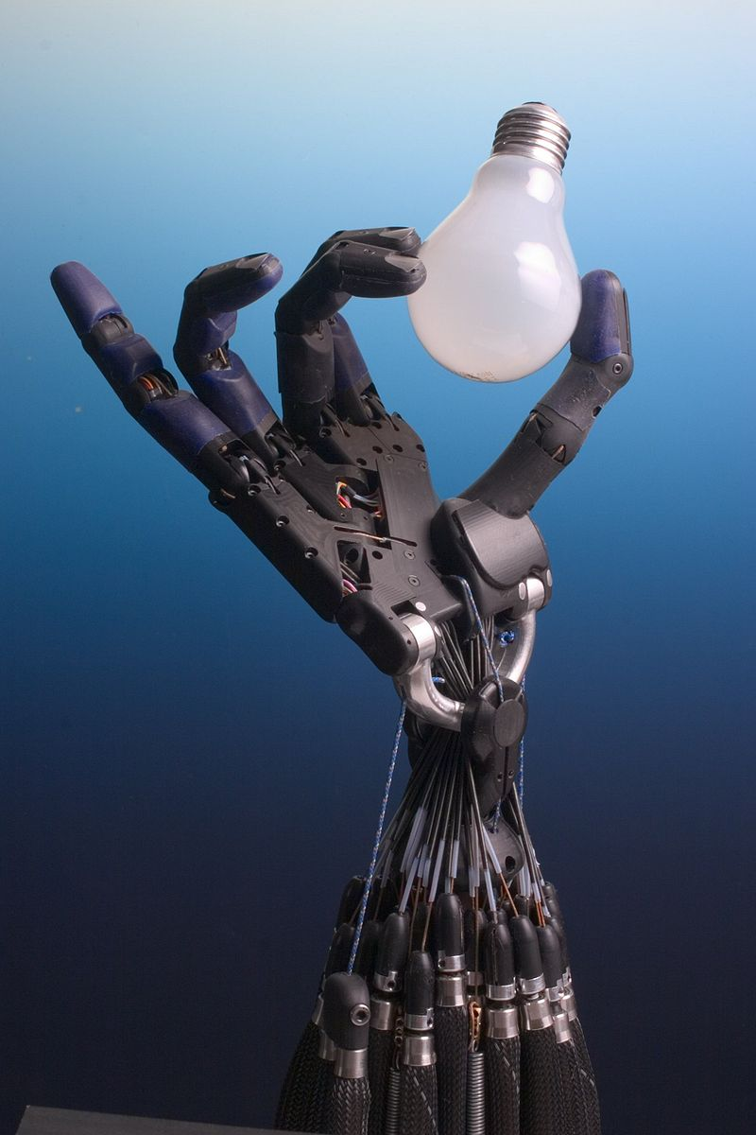
What is Robotics??
Robotics is an interdisciplinary branch of engineering and science that includes mechanical engineering, electrical engineering, computer science, and others. Robotics deals with the design, construction, operation, and use of robots, as well as computer systems for their control, sensory feedback, and information processing.

Slide 3
History

Slide 4
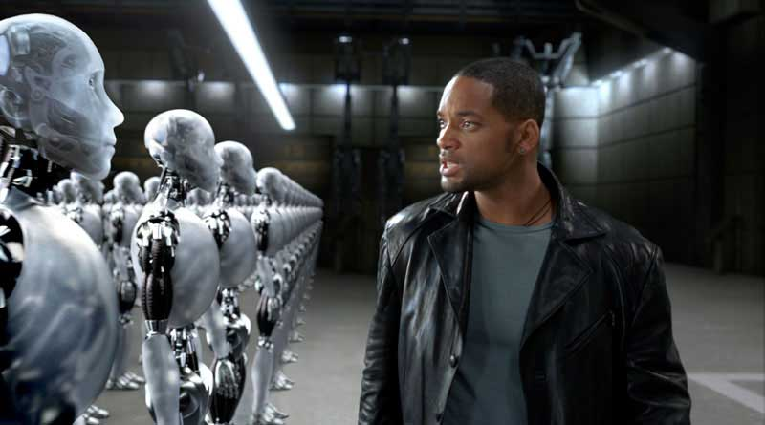

Slide 5
Laws of Robotics
A robot may not injure a human being or, through inaction, allow a human being to come to harm.
A robot must obey the orders given it by human beings except where such orders would conflict with the First Law.
A robot must protect its own existence as long as such protection does not conflict with the First or Second Laws.
Notes:
*The HC-06 acts as a serial port through which you can send and receive data.
*So using a serial terminal or a Bluetooth customized application on your computer or phone, you can control and monitor your project.
*HC06 functions only as slave to a microcontroller

Slide 6
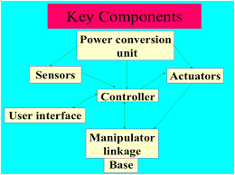

Slide 7
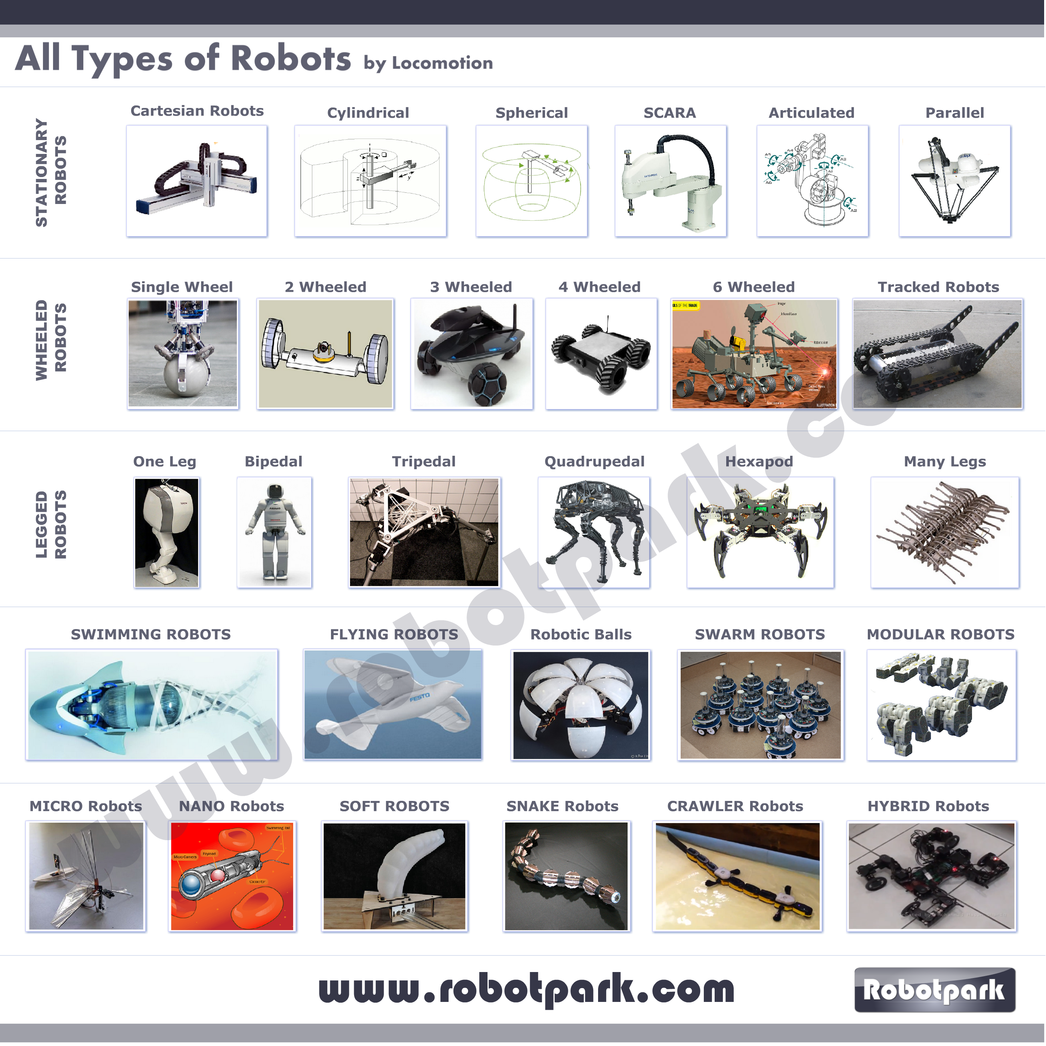

Slide 8
Let’s Start
Notes:
Polylactic Acid (PLA)
Acrylonitrile butadiene styrene (ABS)

Slide 9
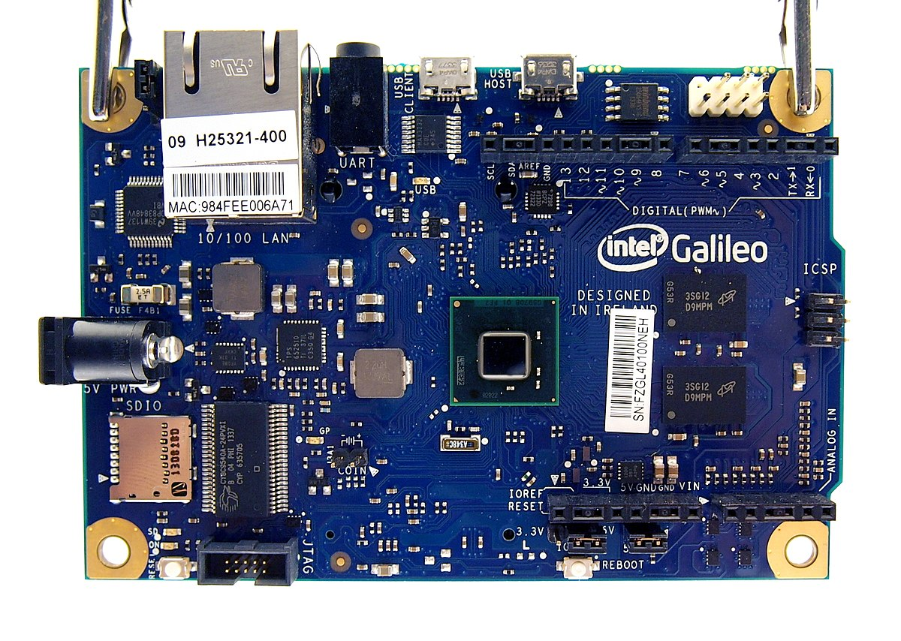
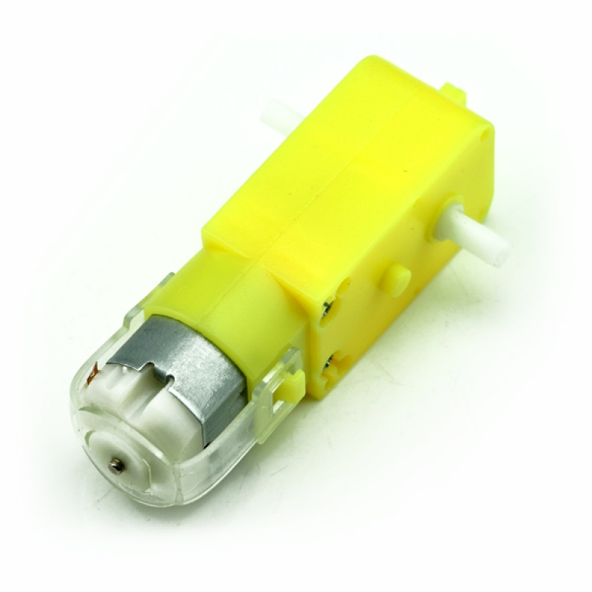
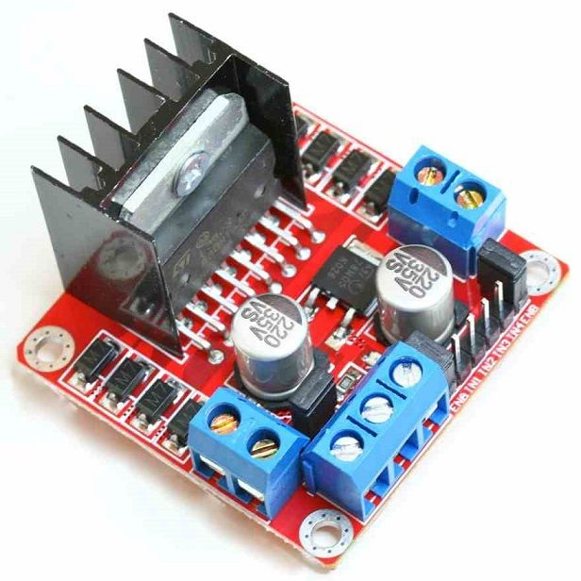
Components

Slide 11
https://www.youtube.com/watch?v=TL62txWNFMY
Notes:
Polylactic Acid (PLA)
Acrylonitrile butadiene styrene (ABS)

Slide 12
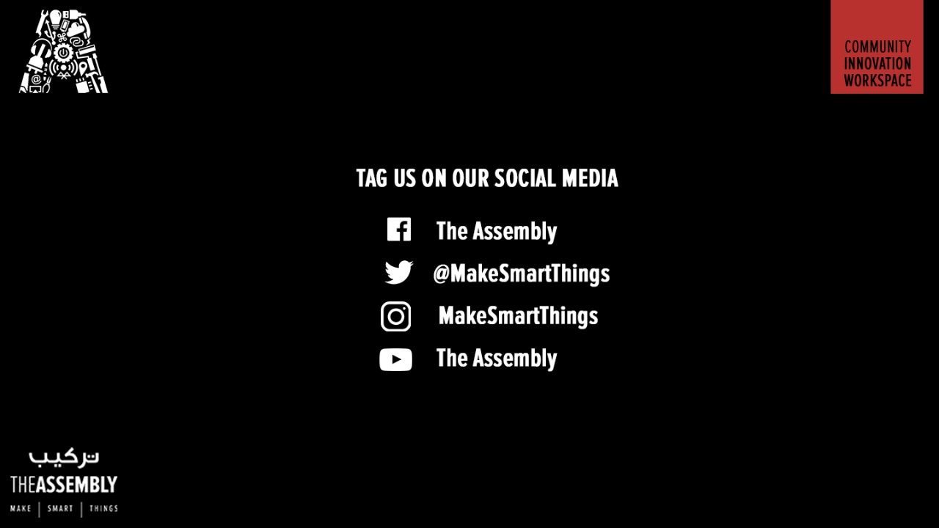
THANK YOU

